Slide 1
What it Takes to Finish Western States
An exploration and analysis of data surrounding the most prominent 100 mile ultramarathon
BY: TOMAS CASTILLO

Slide 2
Overview of Western States (WSER)
Western States Endurance Run was the first 100-mile ultramarathon
Gold standard for 100-mile distance and one of most prestigious ultramarathons
Entry limited to 369 runners due to US Forest permits
Last year (2016) featured 3510 applicants
Lottery system for entry
Automatic entries for select few (~50)
For Example: golden ticket races (must win), top 10 male and female from previous year, pioneers, etc.
Race features top elite runners along with range of amateur athletes (fast and those looking to challenge themselves and just finish)
Bronze buckle for sub-30 hour finish and silver buckle for sub-24 hour finish
NOTE: Strict cutoff at 30 hours

Slide 3
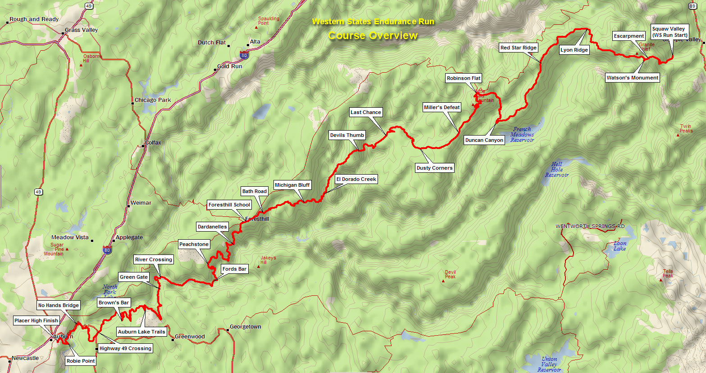
WSER Profile

Slide 4
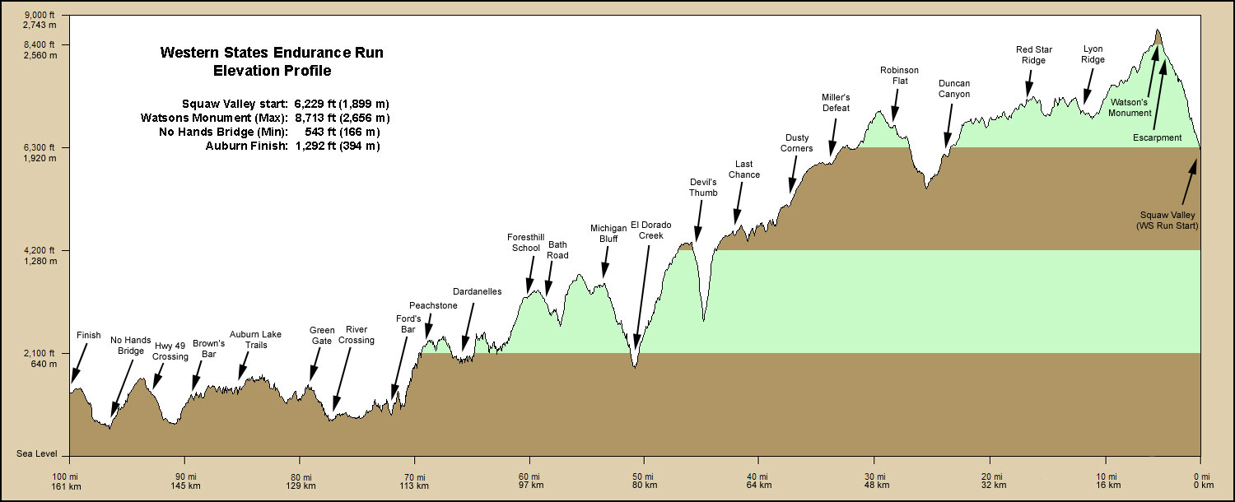
WSER Profile 100.2 miles + 18,000’ ascent + 23,000’ descent

Slide 5
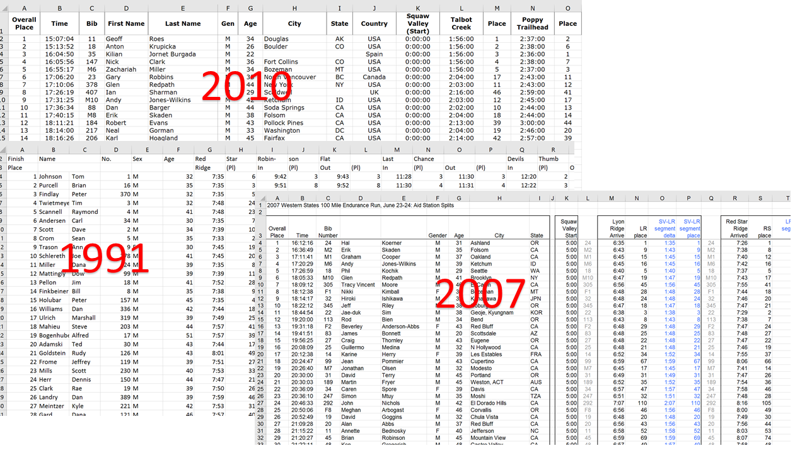
WSER Dataset
Lots of wrangling in excel was required
Formatted into CSV file to import into R
More wrangling required
All data for 1986 – 2016
Race started in 1974
Total of 11,339 starters from data
Information for each race: year, overall place, overall time, name (last and first), sex, age, city, state, ** all aid stations **
Aid station data initially identified a runner’s time and place
NOTE: The time given was time elapsed for some years, and others it was time of day
Final dataset converted all time to minutes, included only times entering an aid station, and excluded the place for aid stations

Slide 6
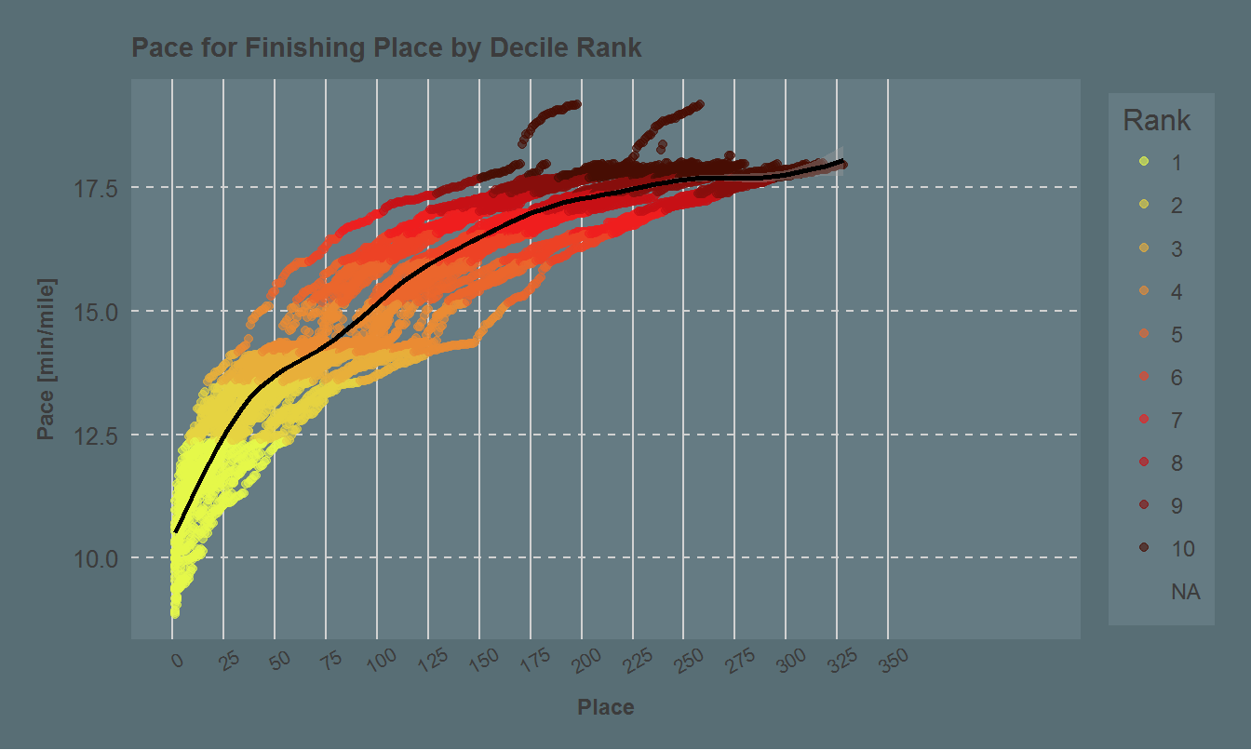
Exploratory Data Analysis (Finishers Only)
> Ranked all racers based on overall time compared to all years -> Rankings by decile (1 = fastest, 10 = slowest)
> Noticeable shift in finish
times approaching 24 hours (1440 minutes)

Slide 7
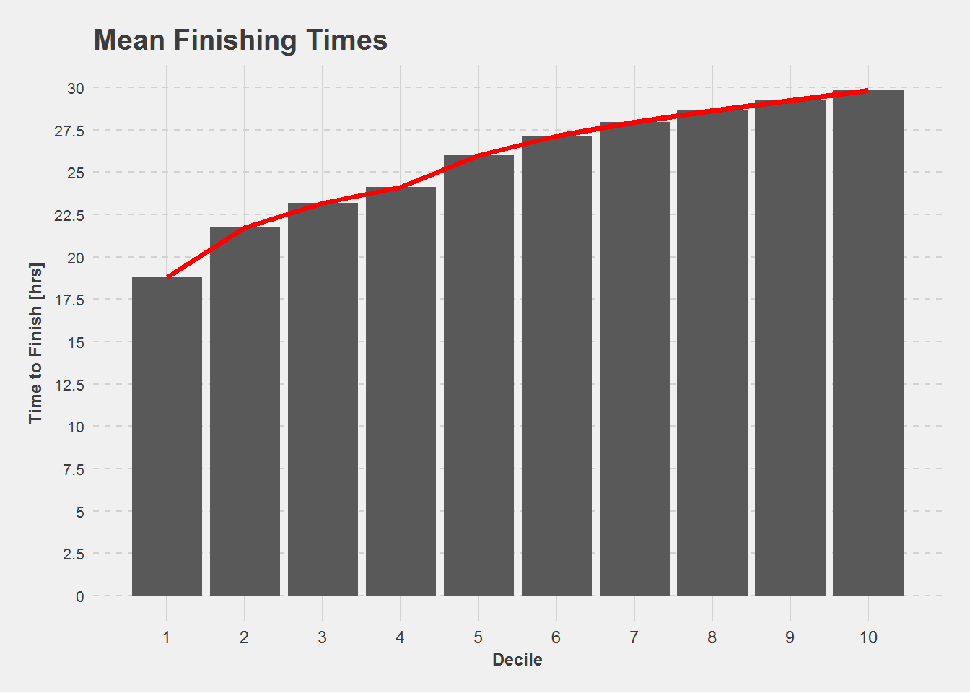
Exploratory Data Analysis (Finishers Only)
> Ranked all racers based on overall time compared to all years -> Rankings by decile (1 = fastest, 10 = slowest)
> Noticeable shift in finish
times approaching 24 hours (1440 minutes)
> Top 4 deciles reach finish in under 24 hours

Slide 8
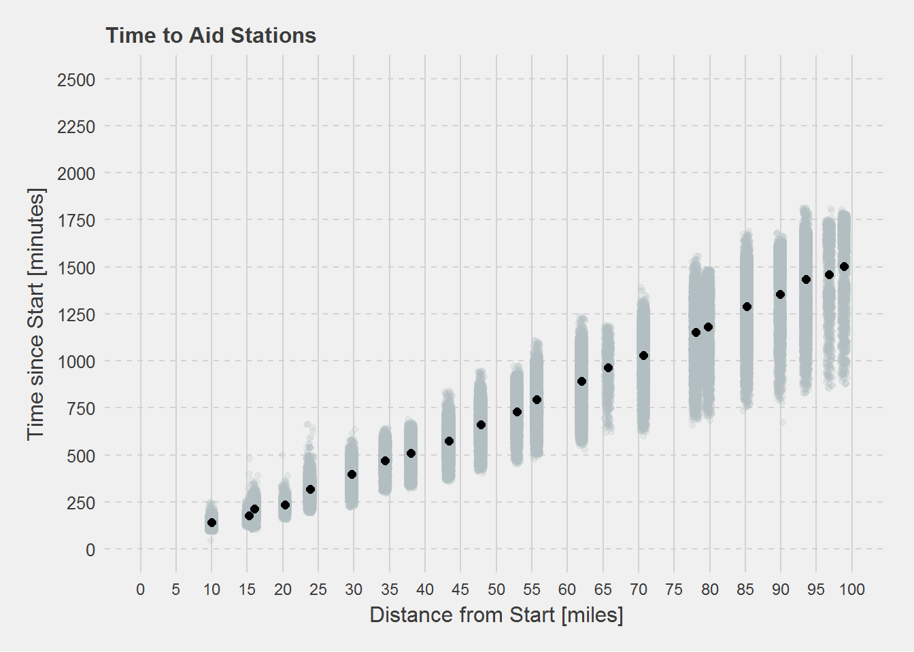
Exploratory Data Analysis (Finishers Only)
> Ranked all racers based on overall time compared to all years -> Rankings by decile (1 = fastest, 10 = slowest)
> Noticeable shift in finish
times approaching 24 hours (1440 minutes)
> Top 4 deciles reach finish in under 24 hours
> Grouping of paces (standard deviation from mean) grows
as race duration/distance increase

Slide 9
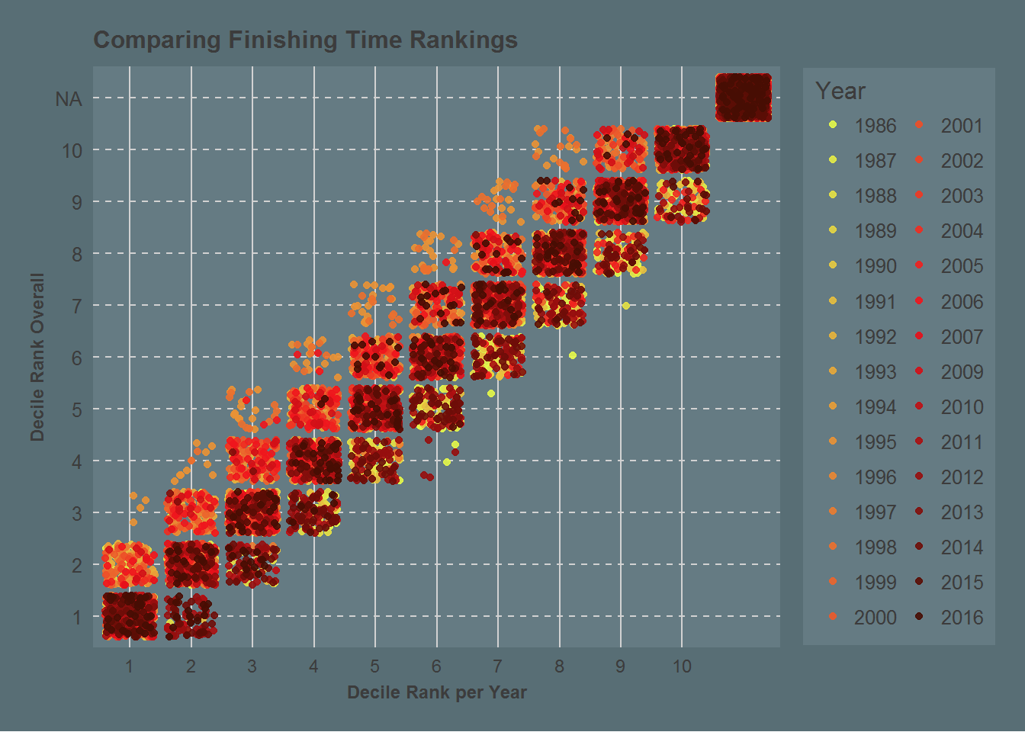
Exploratory Data Analysis (Finishers Only)
> Ranked all racers based on overall time compared to all years -> Rankings by decile (1 = fastest, 10 = slowest)
> Noticeable shift in finish
times approaching 24 hours (1440 minutes)
> Top 4 deciles reach finish in under 24 hours
> Grouping of paces (standard deviation from mean) grows
as race duration/distance increase
> Ranking a runner’s time by respective year vs overall time
Helps visualize and see where some of the faster or slower years were
(an area that can could be explored further)

Slide 10
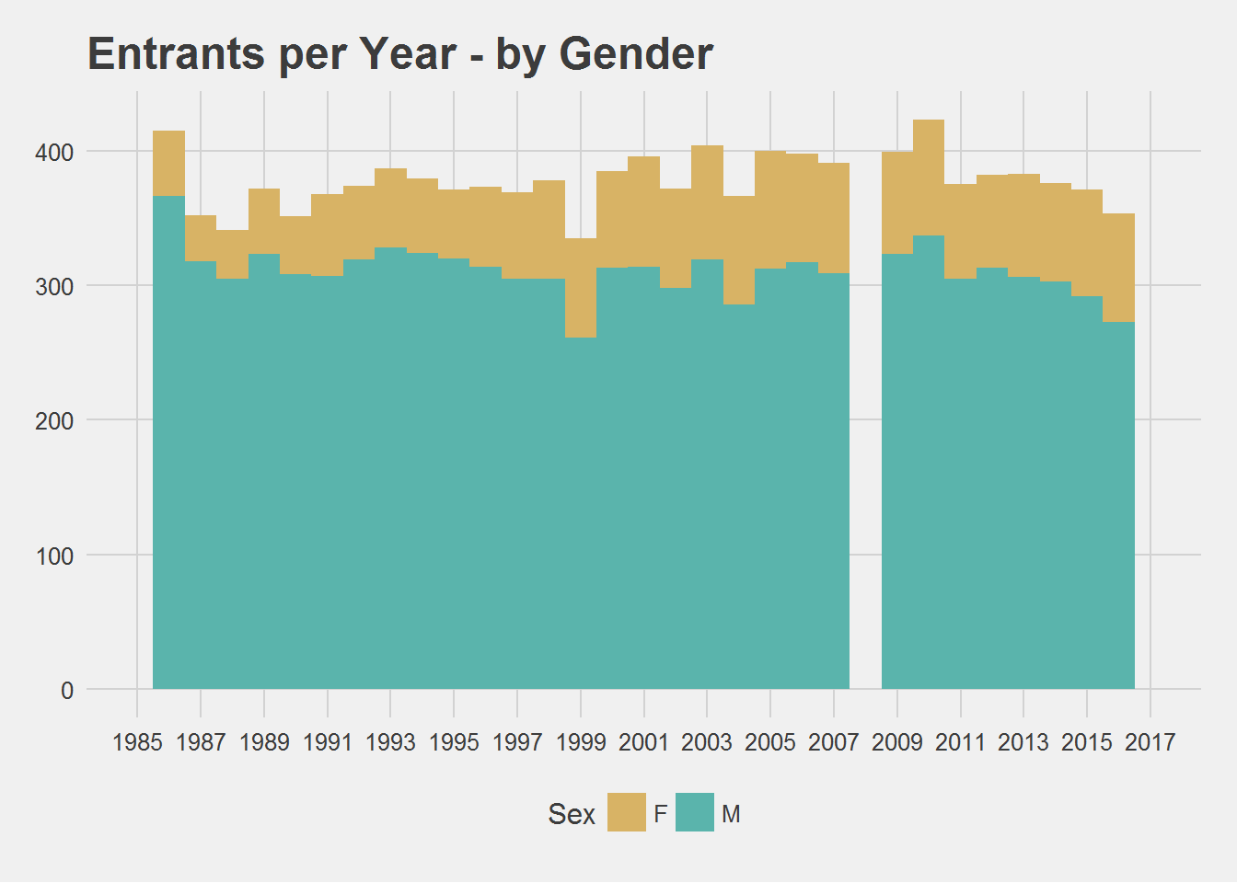
Exploratory Data Analysis (Age and Gender)
> In all years, 18% of starters are female

Slide 11
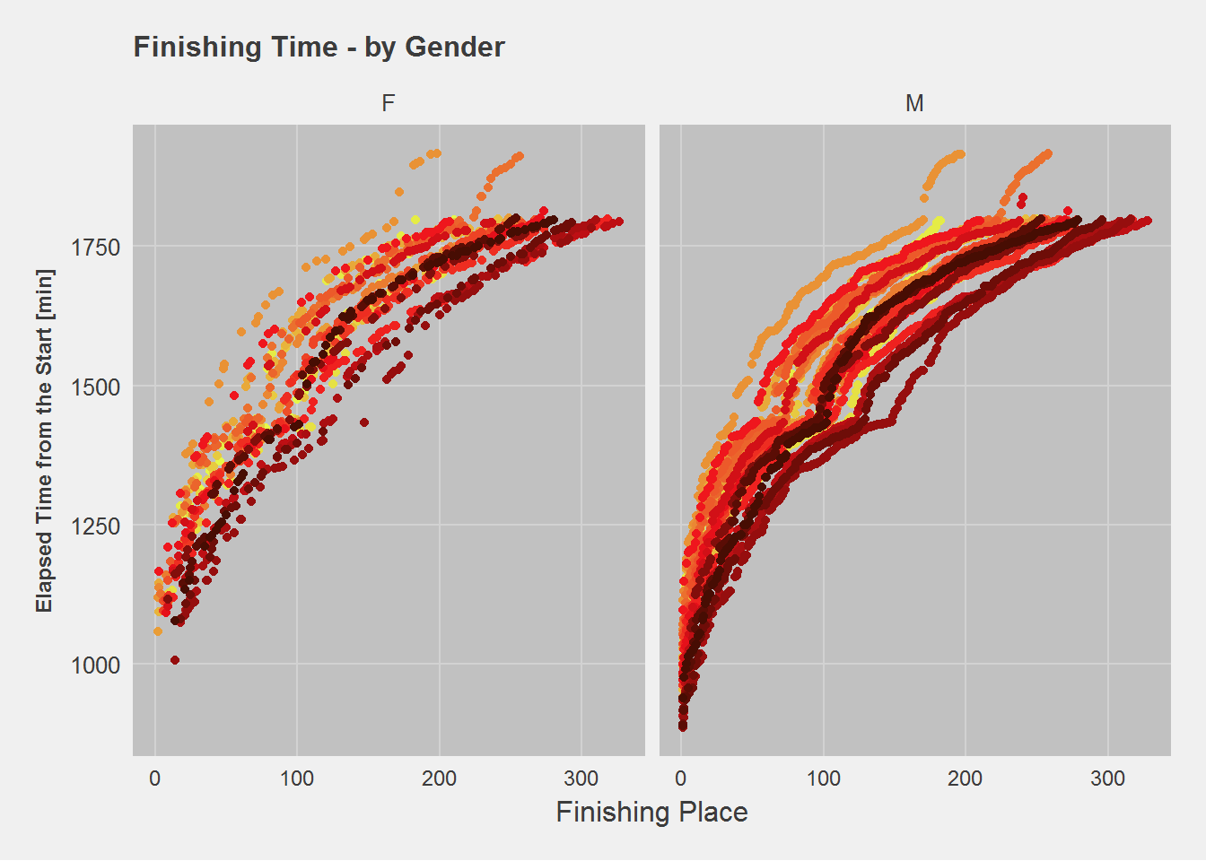
Exploratory Data Analysis (Age and Gender)
> In all years, 18% of starters are female
> Heavy bias toward males would skew model
Excluded from final model
> Final finish times comparable

Slide 12
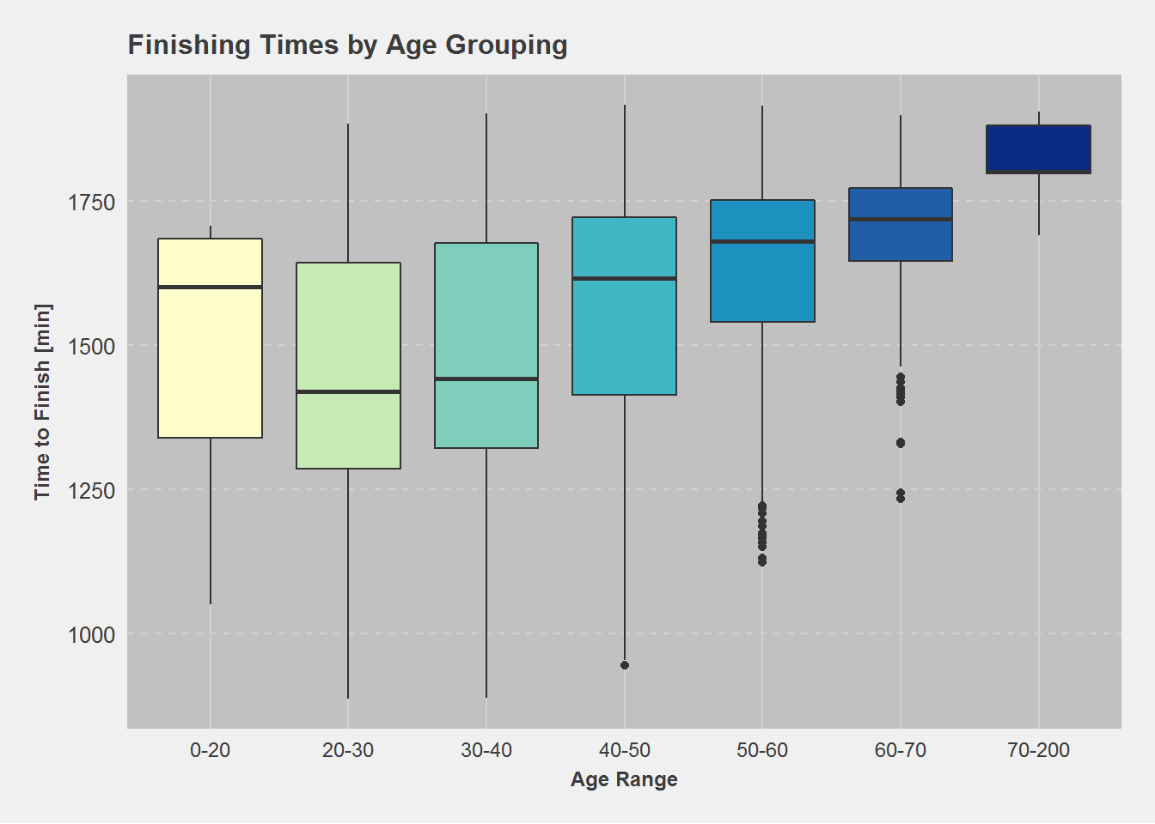
Exploratory Data Analysis (Age and Gender)
> In all years, 18% of starters are female
> Heavy bias toward males would skew model
Excluded from final model
> Final finish times comparable
> 20-30 year olds are fastest group at 23:58
> Fastest time: 14:46:44 by Timothy Olson (28)

Slide 13
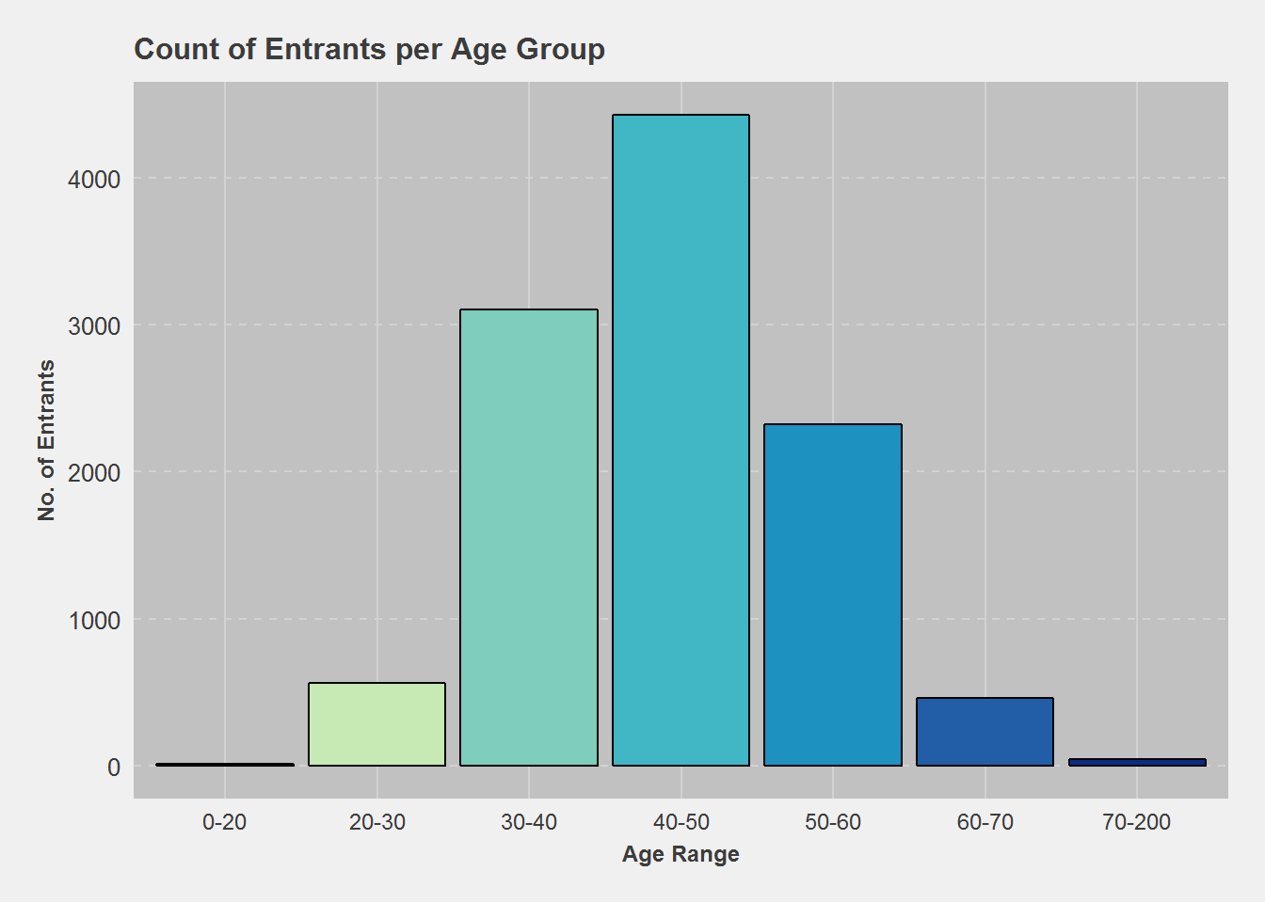
Exploratory Data Analysis (Age and Gender)
> In all years, 18% of starters are female
> Heavy bias toward males would skew model
Excluded from final model
> Final finish times comparable
> 20-30 year olds are fastest group at 23:58
> Fastest time: 14:46:44 by Timothy Olson (28)
> By far, young & fast runners are minority
> Could be due to difficulty getting into race?

Slide 14
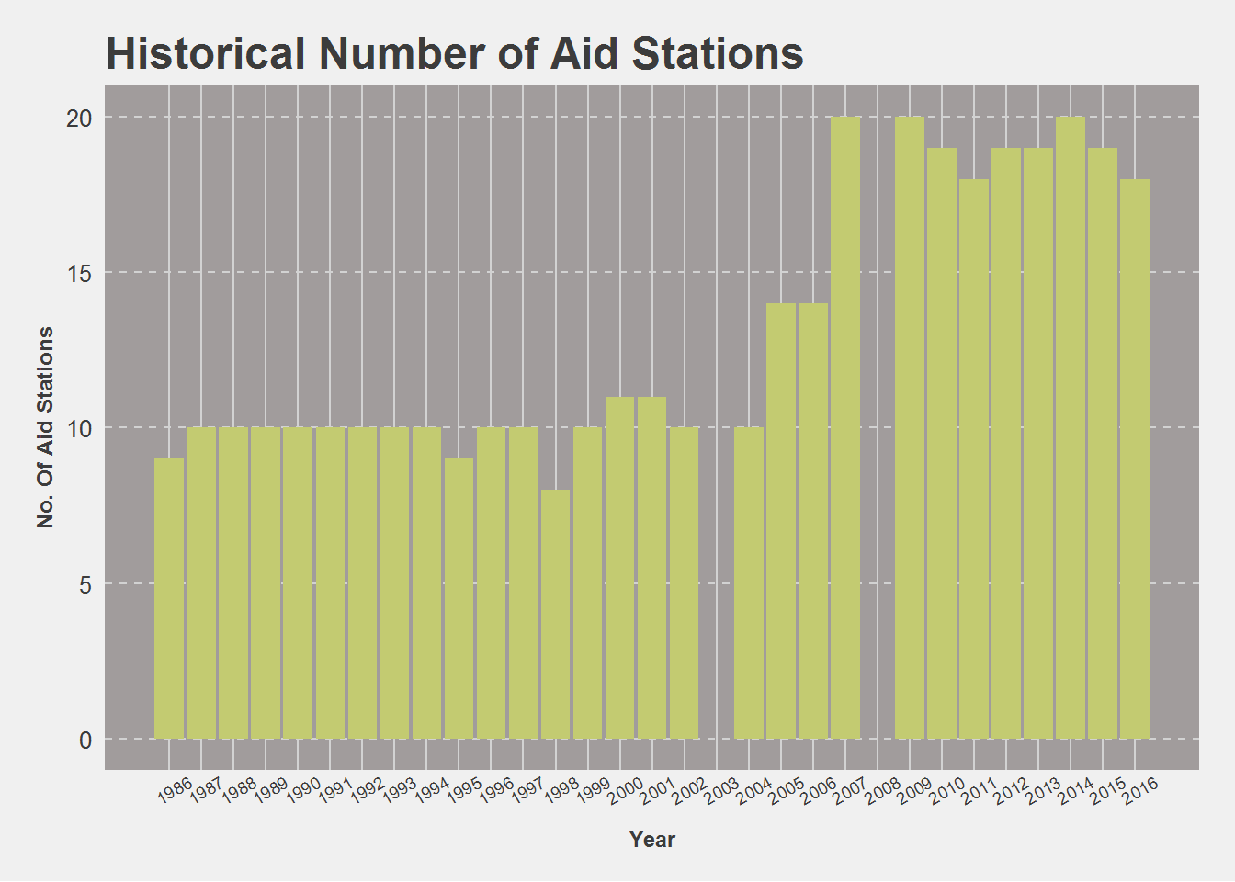
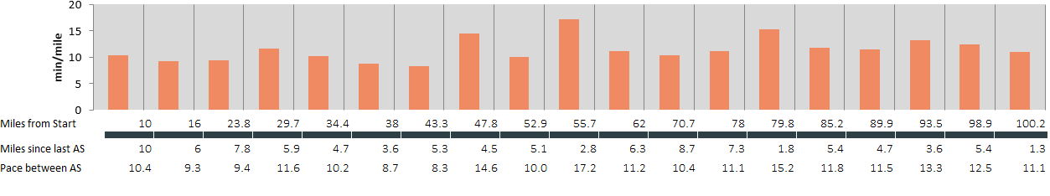
Aid Station Specifics
Aid stations changed over years
Reason could be number of volunteers to record times and/or provide aid
Change of course due to snow or fire
Record of time into aid stations
Distance gathered from WSER website
Feature engineer pace to reach each aid station per runner (pace.as -- 540 min/52.9 miles = 10.2 min/mile)
Add in time and distance between to get pace between and then average and standard deviation for a runner
See below for visualization – pace.avg is mean of pace between Aid stations, pace.sd is standard deviation of all paces for a single runner

Slide 15
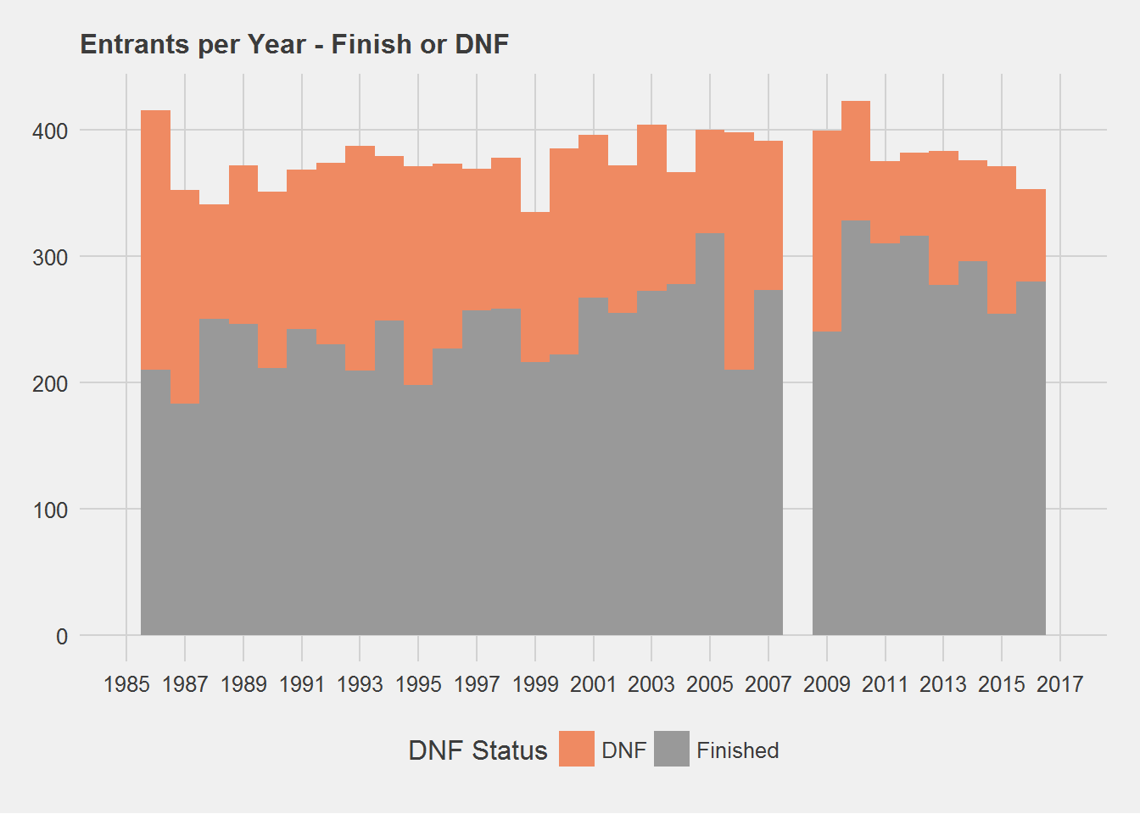
Aid Station Specifics with DNF
Begin analyzing and understanding paces and potential relation to DNF (Did Not Finish)
Overall rate of finishing is 68%

Slide 16
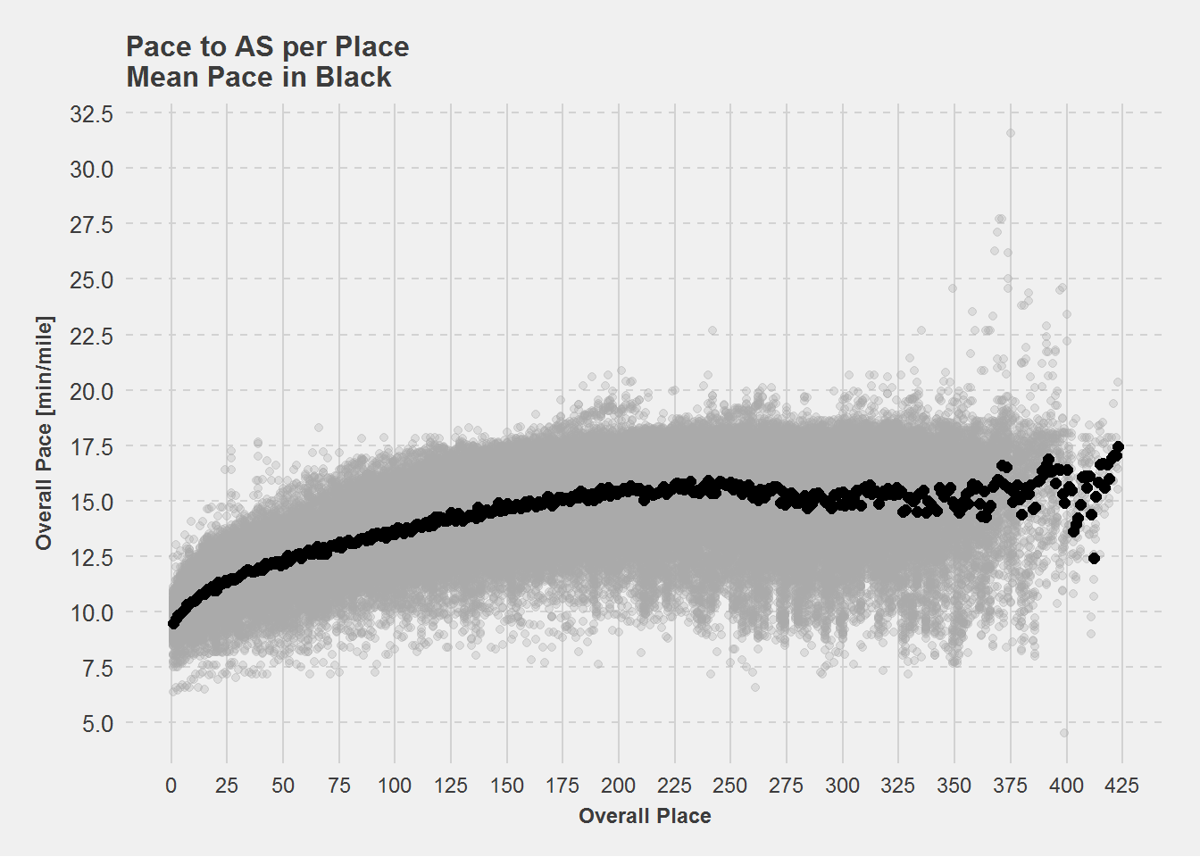
Aid Station Specifics with DNF
Begin analyzing and understanding paces and potential relation to DNF (Did Not Finish)
Overall rate of finishing is 68%
Understood that overall pace into aid stations has a relationship with overall placement

Slide 17
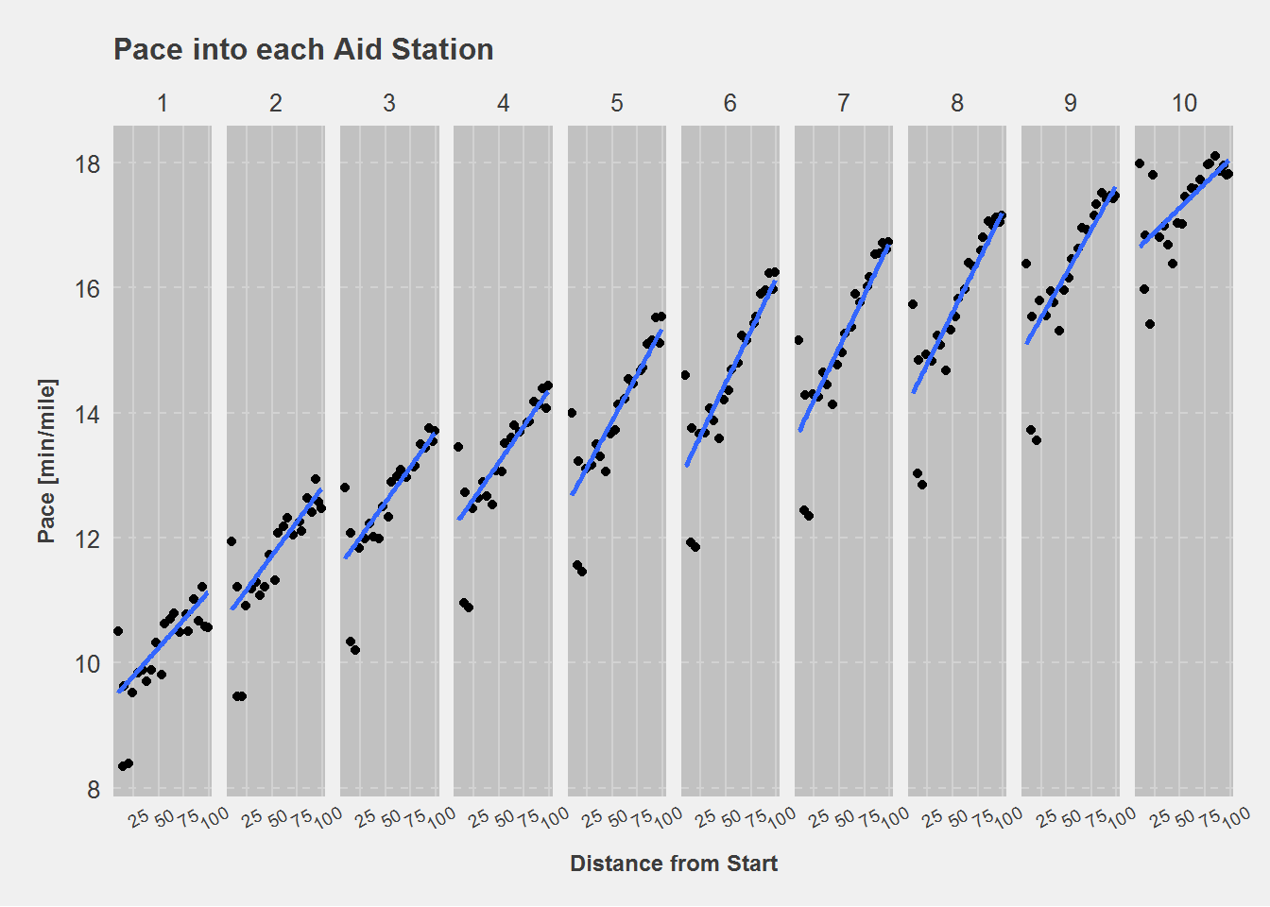
Aid Station Specifics with DNF
Begin analyzing and understanding paces and potential relation to DNF (Did Not Finish)
Overall rate of finishing is 68%
Understood that overall pace into aid stations has a relationship with overall placement
And how the pace over time changes differently for different groups
Potential for future project here to predict finish times

Slide 18
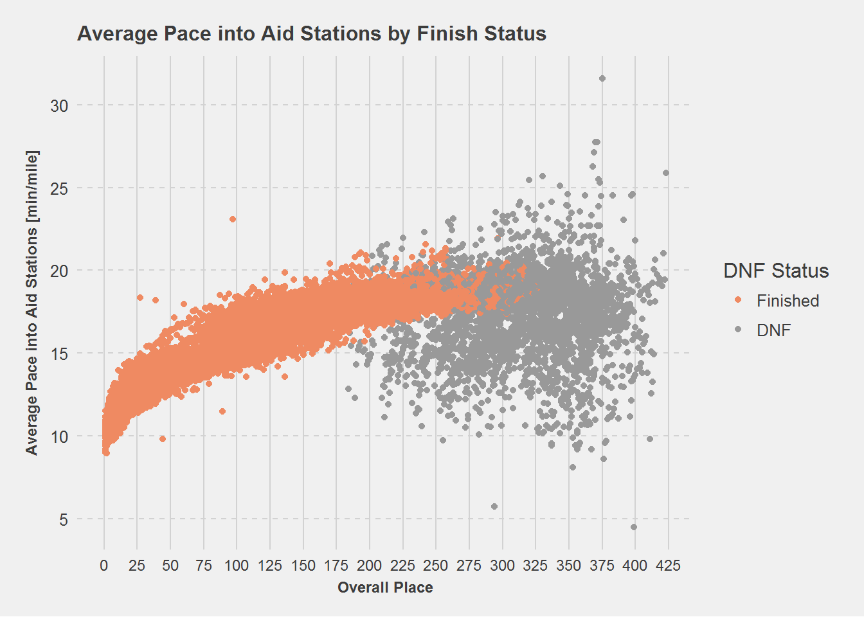
Aid Station Specifics with DNF
Begin analyzing and understanding paces and potential relation to DNF (Did Not Finish)
Overall rate of finishing is 68%
Understood that overall pace into aid stations has a relationship with overall placement
And how the pace over time changes differently for different groups
Potential for future project here to predict finish times
Compare differential pace

Slide 19
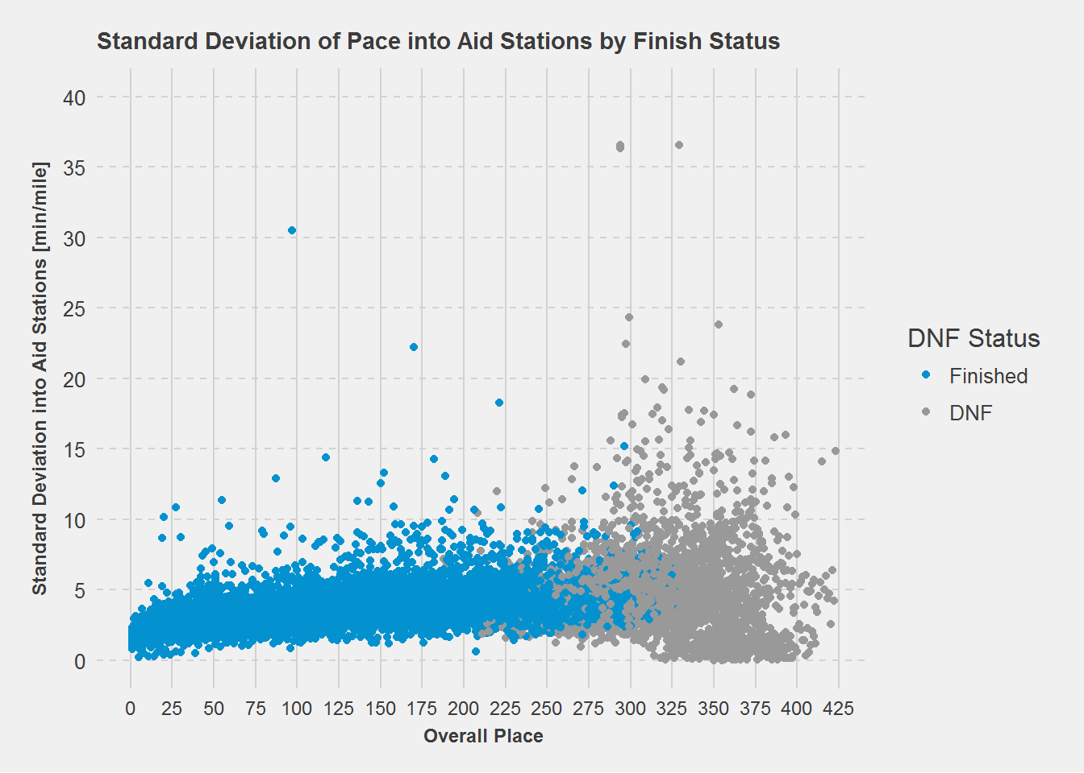
Aid Station Specifics with DNF
Begin analyzing and understanding paces and potential relation to DNF (Did Not Finish)
Overall rate of finishing is 68%
Understood that overall pace into aid stations has a relationship with overall placement
And how the pace over time changes differently for different groups
Potential for future project here to predict finish times
Compare differential pace
And standard deviation per runner
So decided to focus on predicting whether or not a runner will finish the race

Slide 20
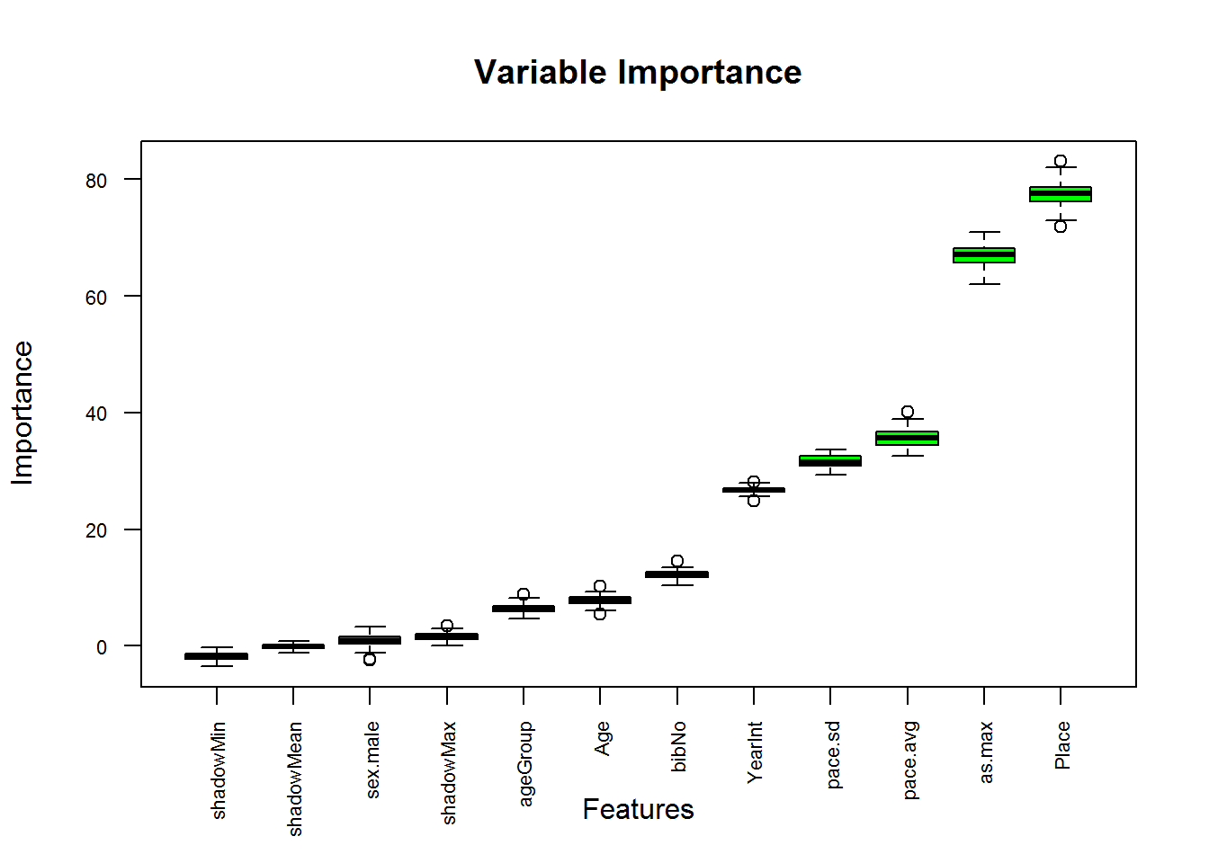
Modeling DNF vs Finishers
First understand variables and which ones would be most useful
Used Boruta::Boruta to characterize

Slide 21
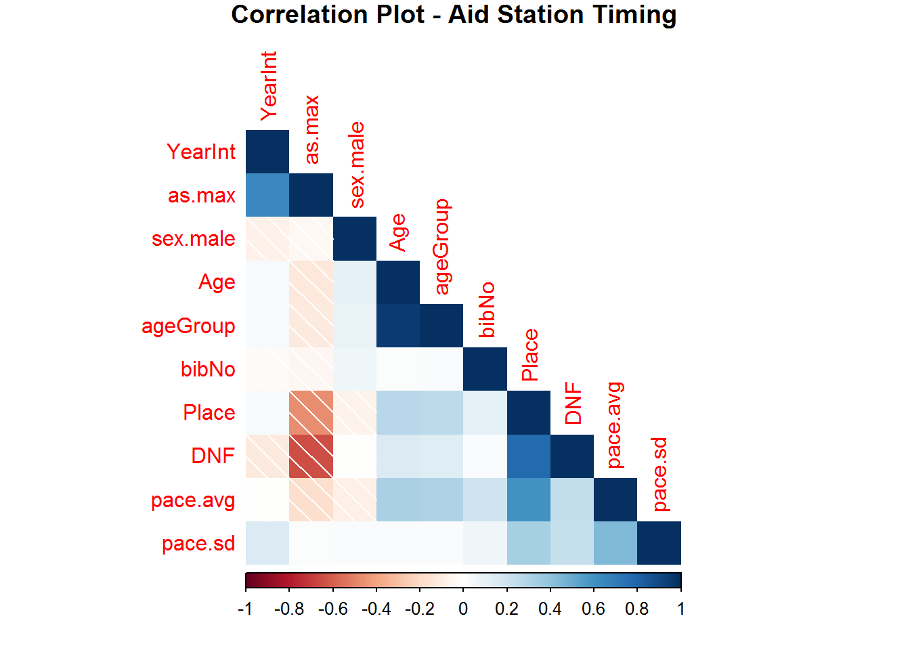
Modeling DNF vs Finishers
First understand variables and which ones would be most useful
Used Boruta::Boruta to characterize
Use correlation plot to visualize potential collinearity
Select variables that make sense and won’t skew model
Use the following to build a final model to predict DNF (0 = Finished, 1 = DNF):
Age, bibNo, pace.avg, pace.sd
Run through following model types to evaluate which ones best predict DNF
Linear regression, logistic regression (GLM), Support Vector Machines (SVM – Radial Basis Function), Decision Tree (CART or RPART), Random Forest, and Neural Network (nnet – 2 hidden nodes)
Formula: factor(DNF) ~ Age + bibNo + pace.avg + pace.sd
Note: Linear Regression is not meant to be used on classification and could not DNF as a factor

Slide 22
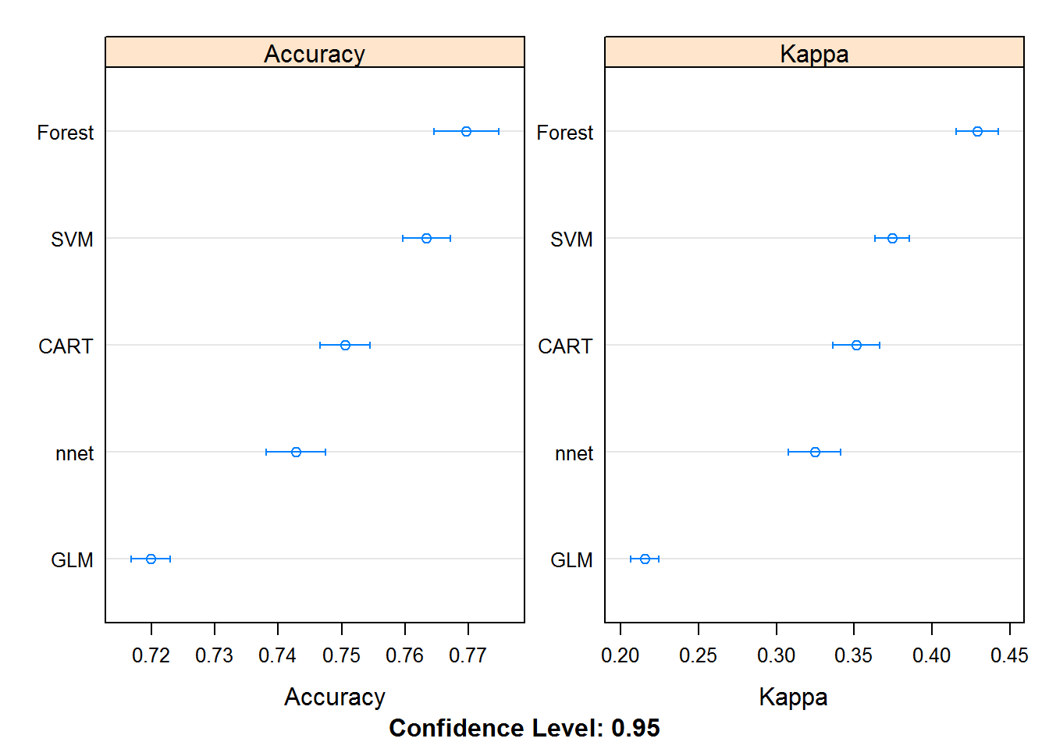
Overview of Model Results
Parameters for each model kept to mostly defaults
Models run using caret’s train function
Additionally used a 10-fold cross validation to run each
Trained model and compared each model based on accuracy of test data
Note could not run Linear Model through caret’s function (accuracy was 71.4%)
Recall: Base model (aka by starting the race) predicts a 68% chance of a finish

Slide 23
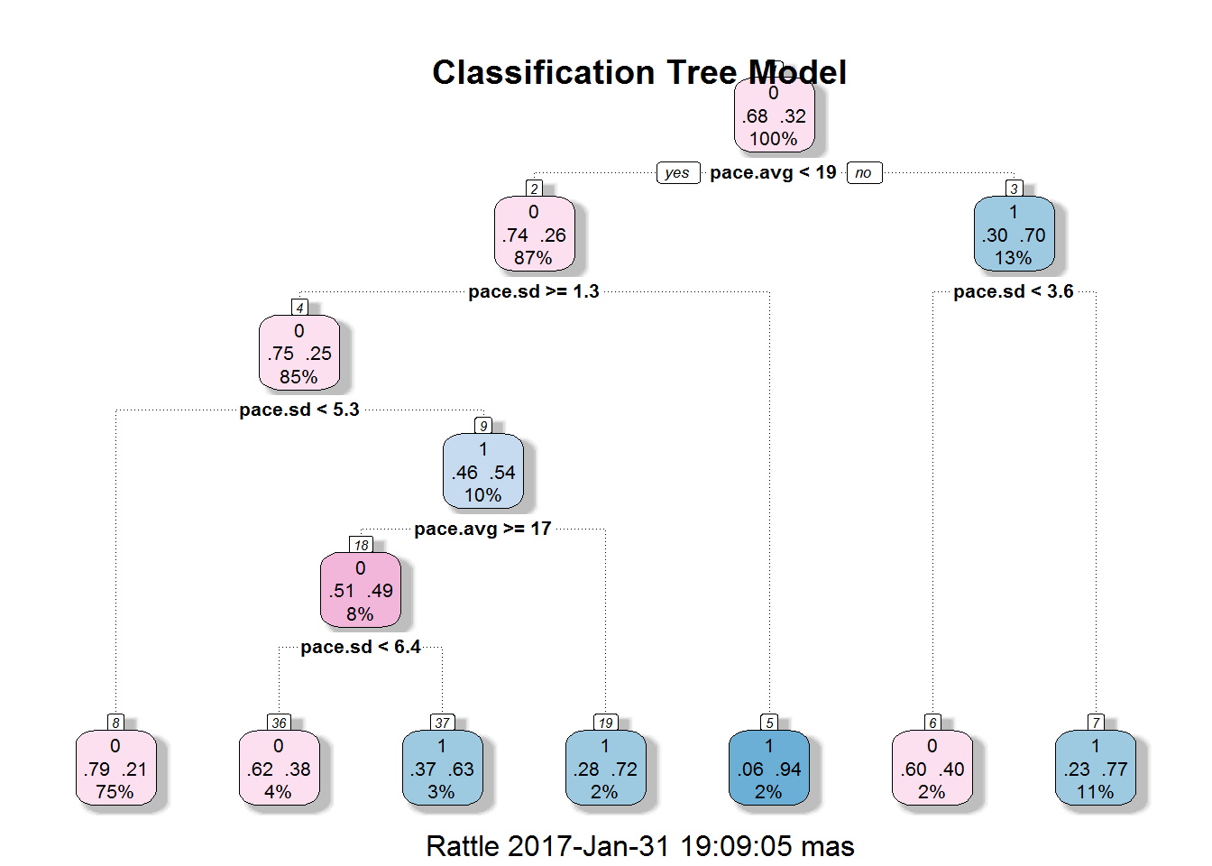
Overview of Model Results (part 2)
Difficulty running CART model through caret’s function
rpart package offered additional flexibility of output
Ran separate model with rpart but not shown in accuracy plot in previous slide (76.9% accuracy)
Output for a decision tree is a logical flow and easy to read and accuracy is similar to Random Forest
Chart output can help to understand cutoffs for different decisions and tailor a race strategy better
While pace.avg has highest significance, pace.sd shows importance in nodes as well
Takeaway – don’t go too fast, and be consistent

Slide 24


Future Enhancements and Client Implementation
A further understanding of geometry and features could improve model
E.g., transform variables differently (ln(pace.sd)), add new features (% of aid stations reached per runner each year), change tuning parameters
Additional trials using different models (ensemble, MARS, etc.)
Acquire additional data
State and Country of origin, time spent at aid station
Elevation data for course
Training data (miles per week, total TSS leading up to race, critical power or pace, threshold power or pace)
Power data over course (total W for course)
2 major companies could benefit from a data model like this
TrainingPeaks or Strava
Both offer ways to track a runner’s progress of training from phone/watch/GPS device
Both offer training programs
Could implement a model like this one into their training program to better tailor goals and give runner’s greater confidence come race day
Pair with TSS or miles/week or threshold pace to help a runner focus on goals that will achieve a good finish
Goes both ways – training data would help improve model’s accuracy
Coaches and self-coached athletes would also greatly benefit from this modeling
They could use a similar approach to TrainingPeaks or Strava

Slide 25
Final Thoughts
Modeling and analysis of data offer opportunities for online training platforms to tailor approaches to athletes
Modeling also allows for runners to understand the challenge ahead for racing WSER
The visualization of data and the story the data tells for different parts of the race is quite fascinating
I look forward to being able to apply this to races outside of WSER along with being able to take in more data and variables to continue improving upon the model
So what does it take to finish at Western States -- don’t start out too fast, and be consistent with pacing! Some grit and mental fortitude never hurt anyone either

Slide 26
Thank you for your time!

